Slide 1
Deep Learning
Wonseok Jung

Slide 2
Introduction

Slide 3
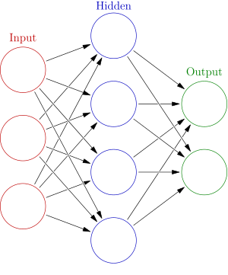

DeepLearning-1
Neural Network
Weight
Bias

Slide 4

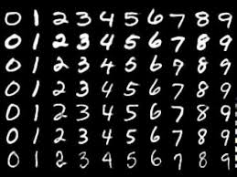
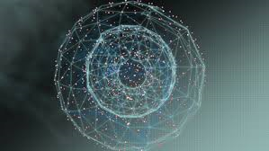
2.Deep learning and Machine learning-1
Machine Learning.

Slide 5
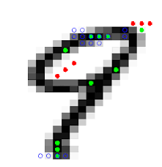
2.Deep learning and Machine learning-2
Feature.
Vector
SVM
KNN

Slide 6
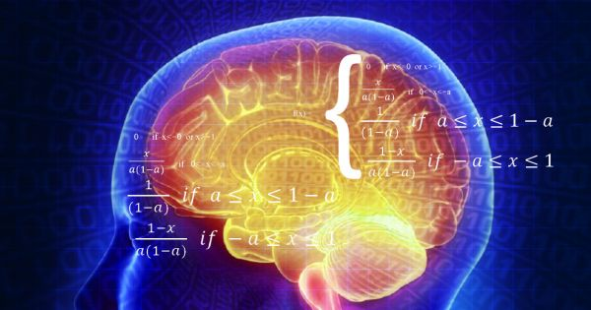
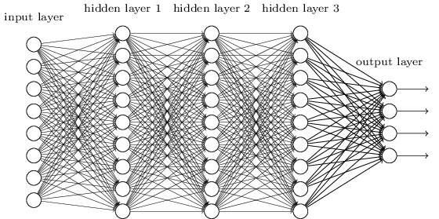
2. Deep learning and Machine learning-3
Output
Machine Learning
SVM
Output
KNN
Output

Slide 7
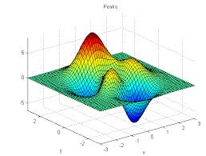

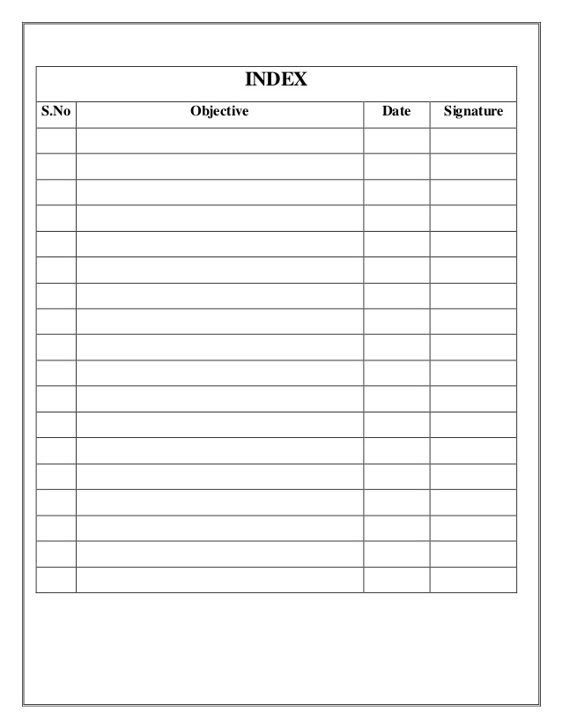
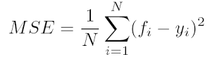
3. Loss Function
Happiness?
My happiness is 20.4

Slide 8
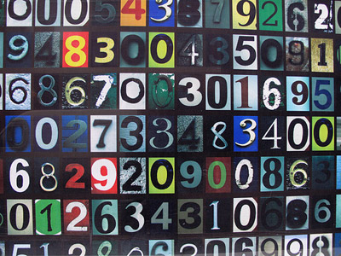

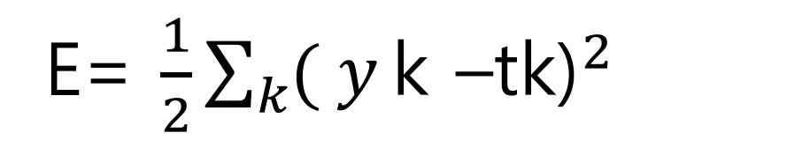
3. Loss Function – MSE( mean squared error )
E= ${\frac{1}{2}\sum_{k}{( y}\text{k} \text{–}\text{tk}\text{)}}^{2}$
y = Output(Softmax)
t = Answer Label
k = Number of Dimension
Example

Slide 9
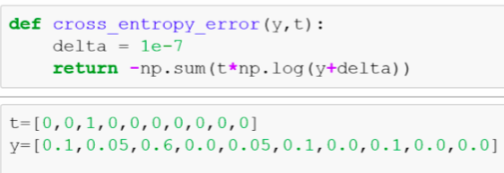
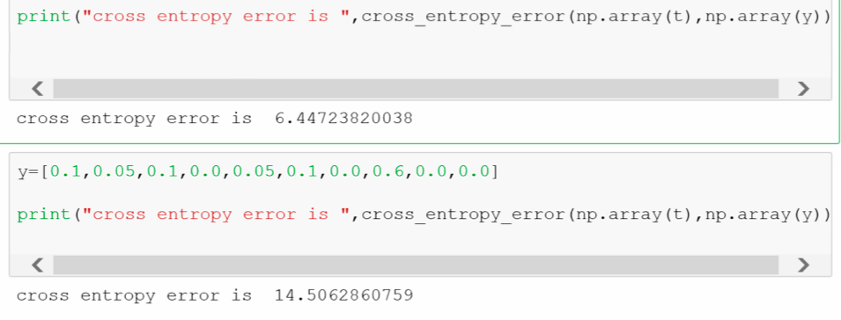
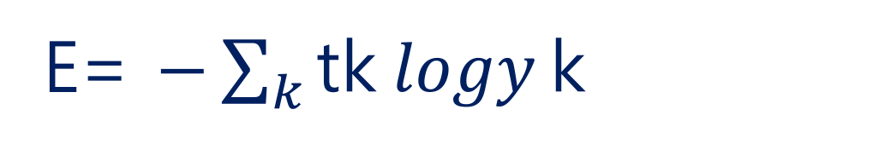
3. Loss Function – Cross entropy error
E= ${−\sum_{k}{\text{tk} logy}\text{k}}^{}$
y = Output(Softmax)
t = Answer Label

Slide 10
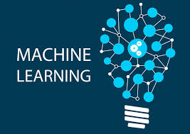

3. Loss Function- mini batch
LOSS?

Slide 11
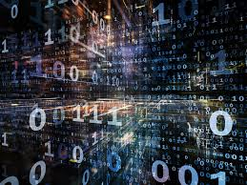


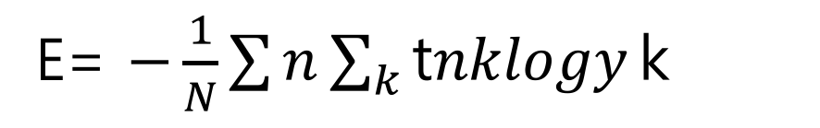
3. Loss Function- mini batch-2
Sum of Cross Entropy
Sum of Cross Entropy
E= ${−\frac{1}{N}\sum{n}\sum_{k}{\text{t}nklogy}\text{k}}^{}$
n, k=nth Data, k-dimension
yk = output
tnk = Answer Label
Mean Square Error
Average

Slide 12
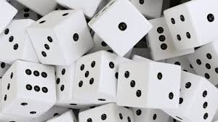

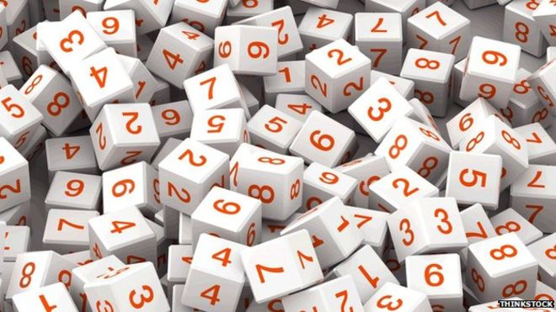
3. Loss Function- mini batch-3
Average
Mini-Batch
Large amount of Data??

Slide 13

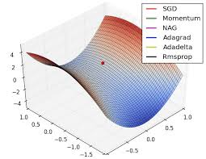
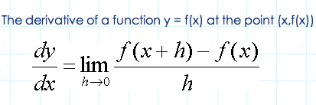

3. Loss Function- Reason?
Accuracy
Optimize
Weight
Bias

